Slide 1



MUKESH PATEL SCHOOL OF TECHNOLOGY MANAGEMENT & ENGINEERING, SHIRPUR
Presentation
on
Demand Forecasting and Inventory Recommendation
for Small Food Retailers
By
1. Yatin Patil 70012300043
2. Chinmay Patil 70012300123
3. Soumy Raghuvanshi 70012300116
Under the Guidance of
Dr. Srikanth Pulipeti
Information Technology Department
MPSTME, Shirpur
Academic Year: 2026-27

Slide 2
MUKESH PATEL SCHOOL OF TECHNOLOGY MANAGEMENT & ENGINEERING, SHIRPUR
Outline
  Problem Statement
  Objective of Project
  Literature Survey
  Proposed Solution
  System Architecture
  Result Analysis/Implementation
  Conclusions
  References

Slide 3
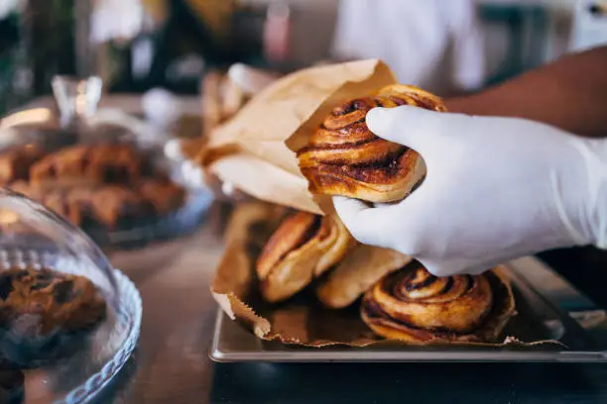

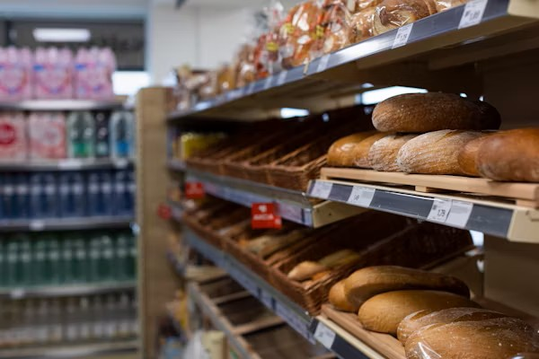
MUKESH PATEL SCHOOL OF TECHNOLOGY MANAGEMENT & ENGINEERING, SHIRPUR
Introduction
Small food businesses lose money on both sides of the same problem: over-order and waste perishable stock, or under-order and lose sales with no forecasting tool built for their scale.
THE PROBLEM
Over- and under-ordering drives food waste and lost revenue for small operators, with no forecasting tool built for their scale.
WHY IT PERSISTS
AI-driven forecasting has matured for large retail chains, but remains inaccessible to small operators without dedicated IT or data teams.
THE TRADITIONAL APPROACH
Small operators currently rely on manual spreadsheets, simple moving averages, or pure gut-feel. These static methods completely fail to account for dynamic demand shocks like sudden weather changes or public holidays.

Slide 4
MUKESH PATEL SCHOOL OF TECHNOLOGY MANAGEMENT & ENGINEERING, SHIRPUR
Objectives
Demand Forecasting: Develop a system to predict future product demand using historical sales data and time-series forecasting techniques.
Inventory Optimization: Recommend appropriate preparation and replenishment quantities based on predicted demand and available stock.
Food Waste Reduction: Identify potential excess inventory and products at risk of wastage to support timely corrective actions.
Data-Driven Decision Making: Provide bakery owners with clear insights and actionable recommendations through an easy-to-use web interface.
External Factor Integration: Incorporate relevant weather conditions and public holidays into demand analysis to account for changes in customer purchasing patterns.
Inventory Monitoring: Enable daily stock updates and maintain inventory information to support accurate forecasting and preparation planning.

Slide 5
MUKESH PATEL SCHOOL OF TECHNOLOGY MANAGEMENT & ENGINEERING, SHIRPUR
Literature Review (Brief)
25 papers reviewed (2024–2026) across five themes: forecasting methods, external regressors, SME data challenges, inventory-to-action, and technology adoption.
Study | Model | Context | Best Metric | Gap Left Open
Susanto et al. (2026) | XGBoost vs MA(7) | SME pre-order, sparse | MAPE 54.20% (MA7) | Regression fails on sparse data
Rahmatillah et al. (2026) | Optimized LSTM | SME ice cream | MAPE 45.06% (LSTM) | Needs ~1,000 days of history
Aqila et al. (2026) | SARIMA / Prophet / LSTM | Coffee shop, hourly | RMSE 0.15 (LSTM) / MAPE 25% (SARIMA) | Forecast-only, no restock
Janchidfah et al. (2026) | TAM (no ML) | Small retail, survey | r = 0.76 satisfaction | No predictive capability
Kamboj et al. (2025) | Prophet + XGBoost | Drug retail, state-level (Germany) | 12–18% MAPE cut (hybrid) | Retail-scale, not SME/food-specific
Guler et al. (2024) | Facebook Prophet | Restaurant, daily | MAE 0.76 | No restock, no mobile delivery
Study
Model
Context
Best Metric
Gap Left Open

Slide 6
MUKESH PATEL SCHOOL OF TECHNOLOGY MANAGEMENT & ENGINEERING, SHIRPUR
Problem Statement
Small food businesses like cafes, bakeries, independent restaurants make daily purchasing decisions with no reliable way to predict tomorrow's demand.
The core disconnect: a cafe owner does not think in RMSE or MAPE — they want to know exactly how many loaves of bread, croissants, or cups of coffee to order tomorrow or make. Across the forecasting literature we reviewed, most studies (Aqila et al., Jatte et al., Gartner et al., Susanto et al.) stop at computing an error metric and never take the final step of producing a purchase quantity.
Forecast-to-Action Gap
Accessibility Gap
Infrastructure Gap
Cold-Start Gap
Predictions rarely convert into an operational restock quantity.
Accurate tools assume enterprise dashboards and IT staff.
Best-performing systems assume IoT hardware or heavy compute.
Deep learning models fail on the short, sparse histories real SMEs.

Slide 7
MUKESH PATEL SCHOOL OF TECHNOLOGY MANAGEMENT & ENGINEERING, SHIRPUR
Proposed Methodology
An end-to-end architecture that turns raw sales data into both a restock quantity and a waste-reduction action, explained in plain language.
NEW
Historical Sales Data
Cold-Start Handling
Prophet + XGBoost
Hybrid Forecast
Restock Logic
Recommendation
Daily item-level sales (bakery dataset)
Day 1–13: category priors
Day 14–30: blended
Day 30+: personal model
Prophet: trend + seasonality
XGBoost: residual correction only
Corrected point prediction, per item, per day
Safety-stock buffer + current inventory
e.g. “Order 15 croissants”
NEW — WASTE PATH
Inventory Aging Check
Waste Action Engine
Waste Action
Flags stock nearing sell-by or low turnover
Uses price-elasticity data to size the discount
e.g. “Mark down 8 croissants 30% today”
Forecast Narrator (LLM) Translates the restock quantity and the waste action into plain-language advice for a non-technical owner narration only, never touches the forecasting math.

Slide 8
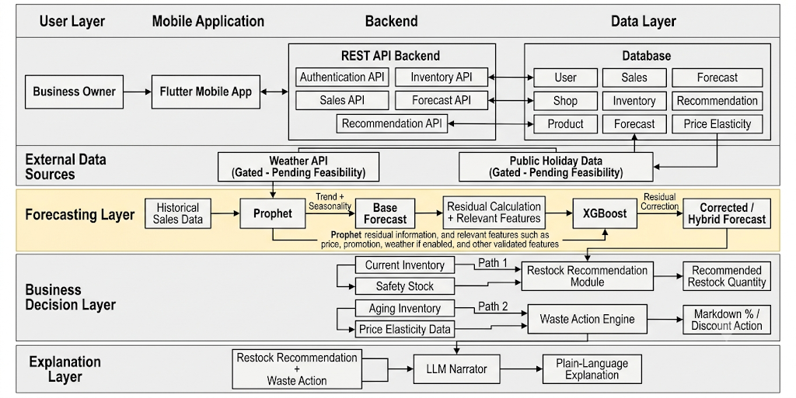
MUKESH PATEL SCHOOL OF TECHNOLOGY MANAGEMENT & ENGINEERING, SHIRPUR
System Architecture

Slide 9

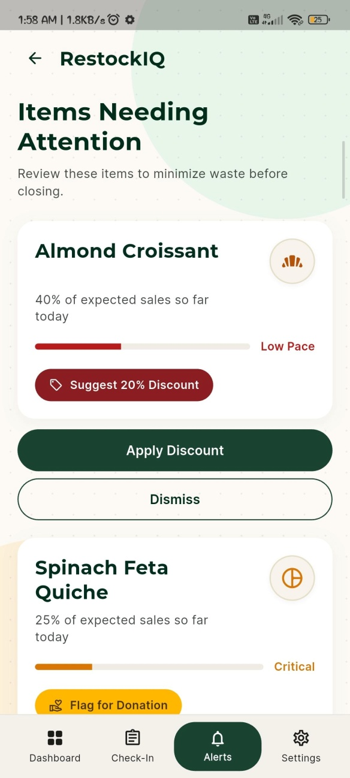
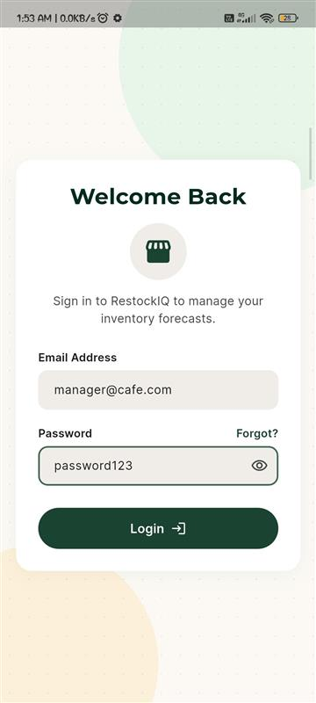
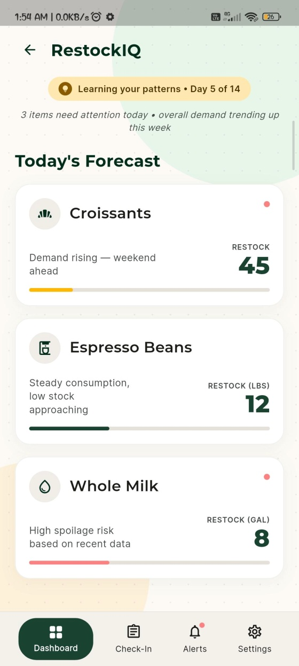
MUKESH PATEL SCHOOL OF TECHNOLOGY MANAGEMENT & ENGINEERING, SHIRPUR
Working Demonstration
Flutter app screens built so far — UI layer only, not yet wired to the backend / live data.
Login / Home Screen
Forecast Dashboard Screen
Waste Action Screen

Slide 10
MUKESH PATEL SCHOOL OFTECHNOLOGY MANAGEMENT & ENGINEERING, SHIRPUR
MUKESH PATEL SCHOOL OF TECHNOLOGY MANAGEMENT & ENGINEERING, SHIRPUR
MUKESH PATEL SCHOOL OF TECHNOLOGY MANAGEMENT & ENGINEERING, SHIRPUR
Implementation
Key modules developed in RestockIQ
Data Import
Import historical bakery sales data through CSV files for product-wise demand analysis.
Demand Forecasting
Implemented time-series forecasting (Prophet with XGBoost) to predict future product demand.
01
02
03
Product & Inventory Management
Developed product management and daily stock check-in functionality to maintain updated inventory.
04
Preparation Recommendations
Connected predicted demand with available inventory to calculate recommended preparation quantities.
Waste Monitoring
Implemented waste alerts to identify potential surplus inventory and support timely action.
Web Interface
Developed an integrated web dashboard for forecasts, inventory monitoring, waste alerts and downloadable reports.
05
06

Slide 11
MUKESH PATEL SCHOOL OF TECHNOLOGY MANAGEMENT & ENGINEERING, SHIRPUR
Results

Slide 12
MUKESH PATEL SCHOOL OF TECHNOLOGY MANAGEMENT & ENGINEERING, SHIRPUR
Conclusion
Key project outcomes and operational impact of RestockIQ
Demand Forecasting
Predicts future product demand using historical sales patterns and time-series forecasting techniques.
Inventory Optimization
Recommends appropriate preparation quantities by considering predicted demand and available stock.
01
02
Food Waste Reduction
Identifies potential surplus inventory and supports timely actions to minimize food wastage.
Inventory Monitoring
Enables daily stock updates to maintain accurate inventory records for better planning.
03
04
Centralized Web Platform
Integrates forecasting, inventory management, preparation recommendations, waste alerts and reporting.
Operational Efficiency
Helps small food retailers make informed decisions, avoid unnecessary overproduction and maintain product availability.
05
06

Slide 13
MUKESH PATEL SCHOOL OF TECHNOLOGY MANAGEMENT & ENGINEERING, SHIRPUR
References (1/2)
[1] K. S. Aqila et al., “Comparative Evaluation of SARIMA, FB Prophet, and LSTM for Hourly Demand Forecasting in Saudagar Kopi,” 2026.
[2] Sandeep V et al., “Smart Sales Forecasting Machine Learning Models for Demand Prediction in Retail,” 2025.
[3] M. Kamboj et al., “State-Level Drug Retail Sales Forecasting Using XGBoost and Facebook Prophet,” 2025.
[4] T. Gärtner, C. Lippert, and S. Konigorski, “Automated Demand Forecasting in Small to Medium-Sized Enterprises,” 2024.
[5] P. Ganguly and I. Mukherjee, “Enhancing Retail Sales Forecasting with Optimized Machine Learning Models,” 2024.
[6] H. Jatte et al., “Optimization of Forecasting Performance in the Retail Sector Using Artificial Intelligence,” 2025.
[7] N. Groene and S. Zakharov, “Introduction of AI-based sales forecasting: how to drive digital transformation in food and beverage outlets,” Discover Artificial Intelligence, vol. 4, no. 1, 2024.
[8] A. K. Güler et al., “Forecasting Restaurant Sales with the Sensitivity of Weather Conditions and Special Days Using Facebook Prophet,” Journal of Data Applications, 2023.
[9] J. C. Susanto et al., “Performance Analysis of Time Series Models to Predict Sales Activity of SMEs,” 2026.
[10] M. A. Munawar and I. D. Sudirman, “LSTM-Based Hourly Sales Forecasting in SME Food and Beverage Retail,” 2026.
[11] S. Vyakarnam et al., “Optimizing Supply Chain Management for Small and Medium-Sized Businesses Using AI: A Comparative Analysis of GPT-4.5, Grok 3, Gemini 2.0, and DeepSeek R-1,” SERA 2025, 2025.
[12] Yuniarty et al., “Technology Acceptance and Security Influences on AI Adoption among Small and Medium Enterprises,” 2025.
[13] T. Aree and P. Ueasangkomsate, “Technology Adoption of MSMEs in Food Supply Chain: The Role of AI in Traceability and Transparency,” 2025.
Review paper submitted at :
ICIMMI 2026 – 8th International Conference on Information Management & Machine Intelligence
ICANET 2027 – International Conference on Artificial Intelligence and emerging Technologies

Slide 14
MUKESH PATEL SCHOOL OF TECHNOLOGY MANAGEMENT & ENGINEERING, SHIRPUR
References (2/2)
[14] K. Somjaipeng and W. Jitsakul, “Factors influencing audit quality through the acceptance and use of AI by auditors in Thailand affiliated with SMEs audit firms,” 2026.
[15] S. Srivastava et al., “Predictive Marketing and Sales Analytics Using Machine Learning for Small and Medium E-Commerce Enterprises,” 2026.
[16] Lalitha R et al., “Enhanced Sales Forecasting of Perishable and Non-Perishable Goods Using Weather Data with Insights on Imports and Price Sensitivity,” 2025.
[17] N. Jain et al., “Weather-Integrated Recommendations for Food Choices with SHAP Explanation,” 2024.
[18] N. U. H. Qureshi et al., “Demand Forecasting in Supply Chain Management for Rossmann Stores using Weather Enhanced Deep Learning Model,” 2024.
[19] I. Rahmatillah, Herwanto, and Sudirman, “Evaluation of Optimized LSTM and Moving Average in SME Inventory Forecasting and Simulation,” 2026.
[20] M. Cherian et al., “Demand Forecasting System for Small Business Optimization,” 5th International Conference on Intelligent Technologies, 2025.
[21] M. Padmavathy et al., “AI-Driven Predictive Analytics for Sustainable Restaurant Operations and Waste Minimization,” 2025.
[22] K. Avuduri and M. L. V, “Smart Stock: Automating Inventory Management for Small Warehouses with Real-Time Intelligence,” 2025.
[23] S. Chowdhury, S. Swetha, and P. Prasad, “Predictive Analytics in Food Supply Chain and Waste Management,” 2025.
[24] G. Sakuda, J. Leon, and R. Rojas, “Mobile Application for the Intelligent Management of Small Shops Using the GPT-4 Model,” 2024.
[25] T. Janchidfah et al., “A Mobile Application for Inventory Management to Support Digital Transformation in Small Retail Businesses,” 2026.

Slide 15
MUKESH PATEL SCHOOL OF TECHNOLOGY MANAGEMENT & ENGINEERING, SHIRPUR
THANK YOU

